Slide 1
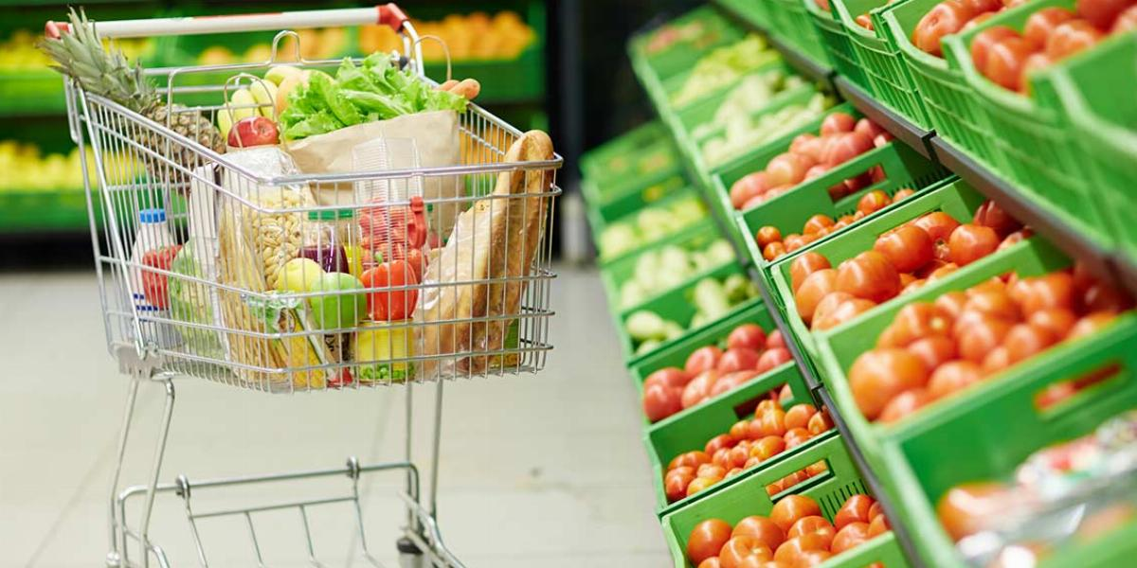
SMART CART RECOMMENDATION SYSTEM
March 19, 2021
Anupama r.k, Queenie Tsang, Crystal (Yunan) Zhu

Slide 2
About SMART CART
LARGE ONLINE GROCERY RETAILER
AROUND 200K RETURNING CUSTOMERS AND 50K UNIQUE PRODUCTS
IMPROVE CUSTOMER EXPERIENCE
INCREASE SAES

Slide 3
SMART CART FUTURE
IMPROVE CUSTOMER EXPERIENCE
DECISSION FATIGUE
RECOMMENDATION SYSTEM
IMPROVE SALES

Slide 4
OBECTIVE
FIND SIMILAR ITEMS USING ITEM BASED COLLABORATIVE FILTERING
FIND FREQUENTLY BOUGHT ITEMS USING ASSOCIATION RULE MINING
RECOMMENDATION BASED ON ITEMS ADDED TO CART

Slide 5
WORK FLOW
TOP SELLING ITEMS
SHOPPING BAG
ORDERS
ITEMS ADDED TO CART
RECOMMENDS FREQUENTLY ITEM BASED ON CART ITEMS
RECOMMENDS SIMILAR ITEMS BASED ON CART ITEMS

Slide 6
Data Understanding
aisles.csv - contains aisle id and aisle description columns
departments.csv - contains department id and department description columns
products.csv - contains product_id, product_name, aisle_id, department_id
order_products__*.csv - These files specify which products were purchased in each order.
order_products__prior.csv contains previous order contents for all customers. 'reordered' indicates that the customer has a previous order that contains the product.
order_products_train.csv contains order information for transactions which will be used for training the model.
orders.csv - This file tells to which set (prior, train, test) an order belongs.
Notes:
reduces a customer’s shopping time,
reminds the customer of what relevant items (s)he might be interested in buying,
helping stores cross-sell in the process

Slide 7
Steps to merge the data sets
1. Merged the aisles data with the products data to obtain Merged dataset 1, so that we know which aisle each product belongs to.
2. Combined the Merged dataset 1 with the department data to obtain Merged dataset 2, so we know which aisle and department each product is from.
3. Added Merged dataset 2, which contains product full information, to order_products__train and order_products__prior files, respectively, to obtain Merged dataset 3 (Train) and Merged dataset 4 (Prior), so that we know the product information (e.g., product names, aisles and departments they belong to) of the products in the training and prior orders.

Slide 8
structure of original dataset

Slide 10
Notes:
People mostly order from 8:00 - 17:00 (8AM - 5PM)

Slide 12
Notes:
p2 <- X %>%
group_by(user_id, product_id) %>%
dplyr::summarise(count3=n()) %>%
select(user_id, product_id, count3) %>%
ungroup() %>%
group_by(user_id) %>%
dplyr::summarise(count_product=n()) %>%
ungroup()

Slide 13
Count of Products sold by department

Slide 14
When are orders placed (Day of week)?

Slide 15
transactions by days since prior order

Slide 18
Data Preparation for Association RULE

Slide 19
Transaction data in Transaction format
Notes:
all the items within a transaction are in the same row

Slide 20
Association rule
List of items with the same order ID are studied as a group – user information will not be taken into consideration.
Goal: to recommend frequently bought together items
Metrics to measure the strength of the rules
Support: how frequent an itemset is in all the transactions – value we use: 0.0005 (the itemset should occur in at least 0.05% of all transactions)
Confidence: the likeliness of occurrence of consequent on the cart given that the cart already has the antecedents – value we use: 0.4
Lift: the rise of the confidence that {X} provides to us for having {Y} on the cart (whether X increases the chance of buying Y).
Notes:
Note: The confidence for an association rule having a very frequent consequent will always be high
Lift is the measure that will help store managers to decide product placements on aisle.
Apriori - All subsets of a frequent itemset must also be frequent - if we drop out an item from an itemset, support value of new itemset generated will either be the same or will increase.
Apriori principle allows us to prune all the supersets of an itemset which does not satisfy the minimum threshold condition for support. For example, if {Milk, Notebook} does not satisfy our threshold of minsup, an itemset with any item added to this will never cross the threshold too.
Pruning of infrequent itemsets could reduce the number of itemsets to be considered by more than half!

Slide 21
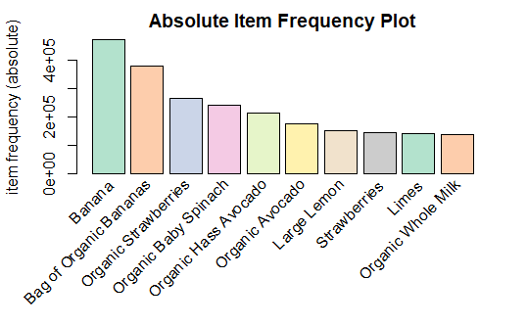
Association rule
In total, there are 3,214,874 unique orders and 49,677 unique product names
We chose the top 50 products to mine the rules
Less frequently bought items have less chance of appearing in any rules
Less frequently bought items will not affect the rules much
61 rules

Slide 22
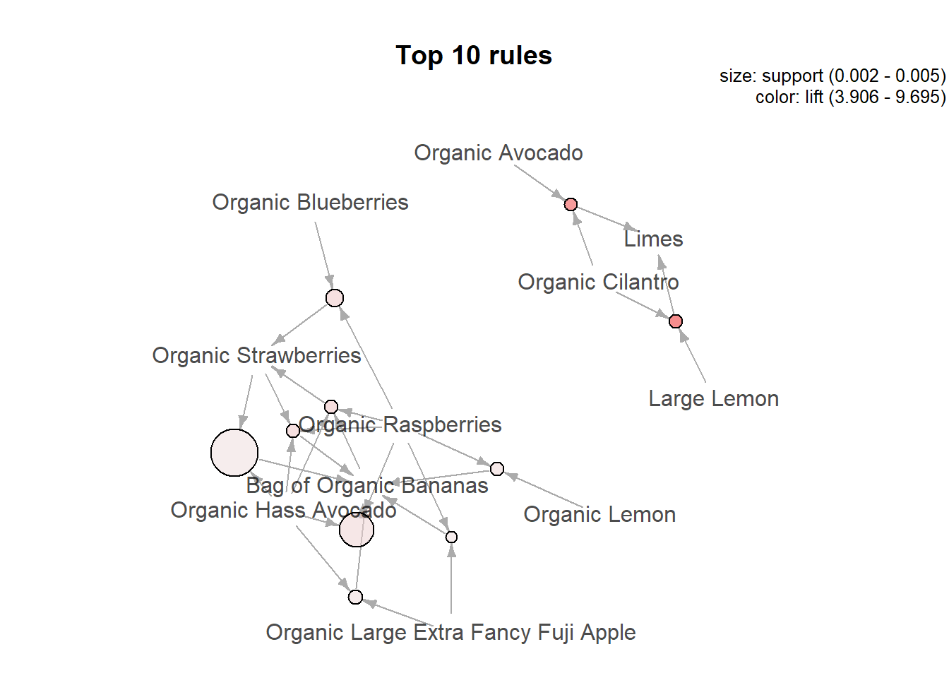
Mined rules
lhs |  | rhs | support | confidence | lift
{Large Lemon, Organic Cilantro} | => | {Limes} | 0.00101 | 0.407 | 9.311
{Bag of Organic Bananas, Organic Lemon, Organic Raspberries} | => | {Organic Hass Avocado} | 0.00057 | 0.452 | 6.811

Slide 23
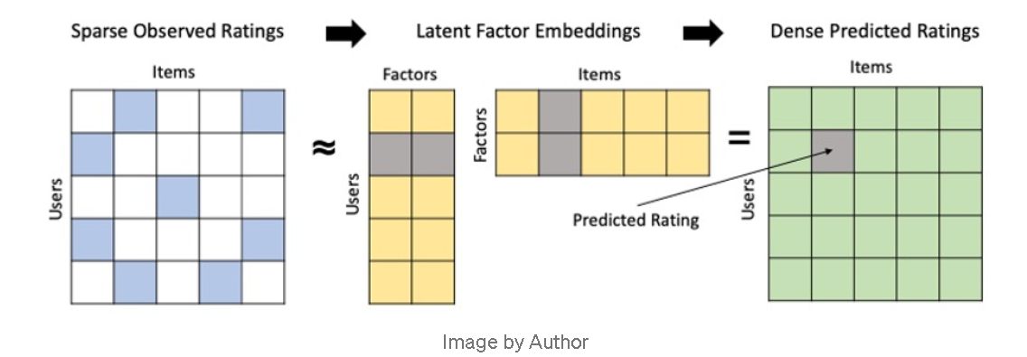
Weighted Alternating Least Squares (W-ALS) AND MATRIX FACTORISATION

Slide 24
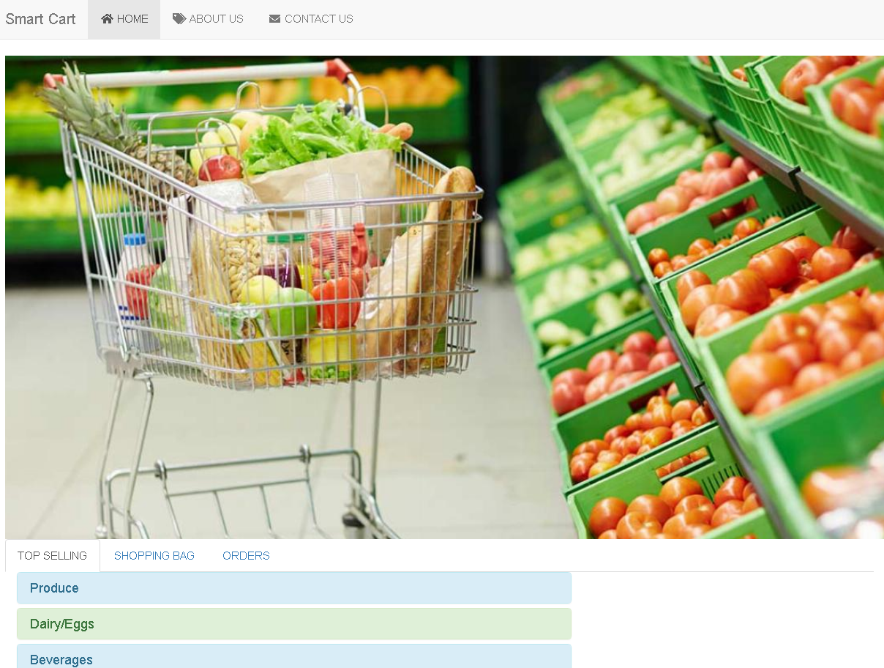
APPLICATION

Slide 25
RecommenderLab FOr evaluation of different Recommender Systems
compare common algorithms typically used to create recommendery systems.
2 types of rating matrix for modelling is available
we will be using the binary rating matrix type where 0 indicates product is not purchased, while 1 indicates product is purchased.
Notes:
Binary rating matrix is useful when no actual user ratings is available, and it also does not require normalisation.
The rating matrix must be rearranged with orders in rows and products in columns.

Slide 26
Evaluation scheme and Model validation
Evaluate the model’s effectiveness using recommenderlab’s evaluation schemes.
Split the data into a training set and test set with train taking 80% of the data and test taking 20% of the
data.
Set method=“cross” and k=5 for 5 fold cross-validation. Data will be split into k subsets of equal size, and
80% of data will be used for training and last 20% for evaluation. Models are then estimated recursively
5 times, and a different train/test split is used each time.
Results are then averaged to produce a single evaluation set

Slide 27
Set up a list of algorithms
Create a list of algorithms from recommenderlab and specify model parameters. Pass the scheme and algorithms to the evaluate() function, to evaluate several recommender algorithms using an evaluation scheme. The end product is a evaluation result list.
v
Notes:
Consider schemes which
evaluate on the binary rating matrix and include random items algorithm for benchmarking
elect type= topNList to evaluate a Top N List of product recommendations and specify how many recom_x0002_mendations to calculate with the parameter n = c(1,3,5,10,15,20)

Slide 31
Thanks for Listening!

